Slide 1
Reverse-Engineering the Logic of an Electric Car Charging System with AI
Urh Prosenc
Adam rychert
Evgenii posashkov
Advisor:
doc.dr. jure demšar

Slide 2

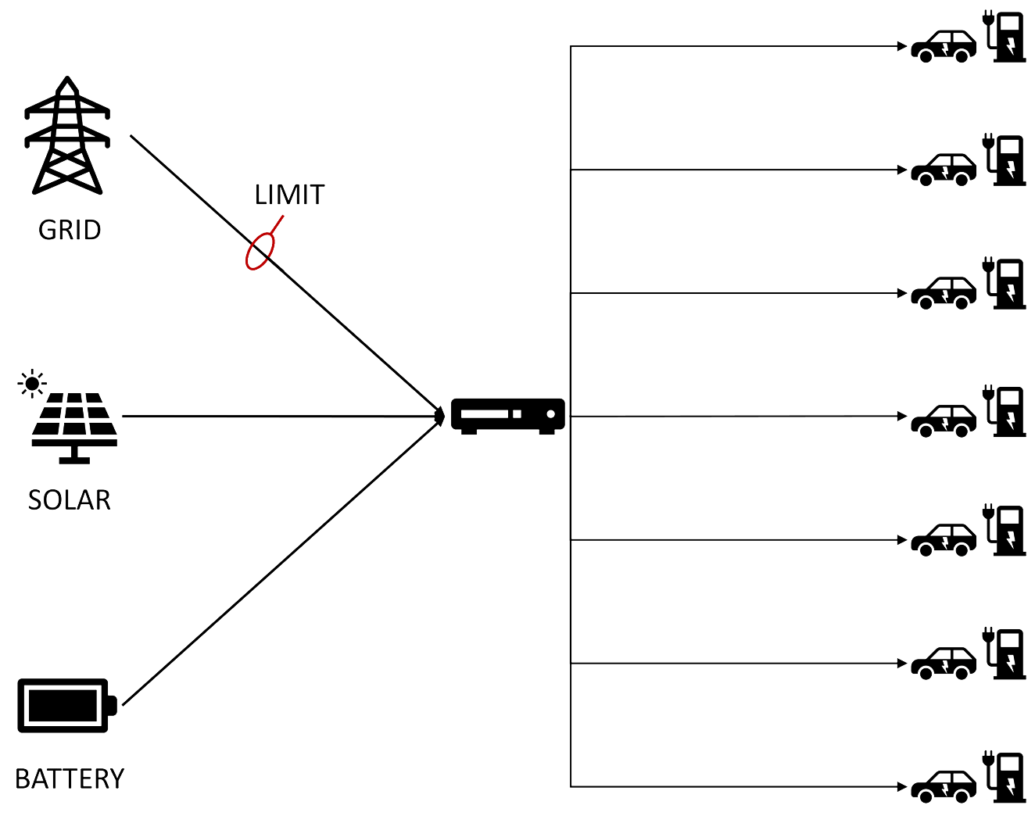
GROUND TRUTHS
Battery SOC >80% - Charging covered by battery
Battery SOC > 40% - Charging covered by battery if demand > limit
Battery SOC < 40%
Demand > limit – Charging partially covered by battery
Demand < limit – Battery charged from the grid
Battery SOC < 15% - Battery discharge stopped

Slide 3
Direction of the project
Replicate the system’s behavior with a model
Compare two different approaches
Logic Tensor Networks (LTN)
Deep Neural Network
Focus on deeper explainability
Rule satisfaction and potential rule-enhanced learning
Focus on accuracy
Explainability with post-hoc methods
SHAP
Counterfactual

Slide 4
Dataset exploration
Comparison with GROUND TRUTH:
Limited dataset (no instances above 80%)
Battery doesn’t operate at full capacity
Still providing power under SOC 15%
Overall ~16% compliance

Slide 5
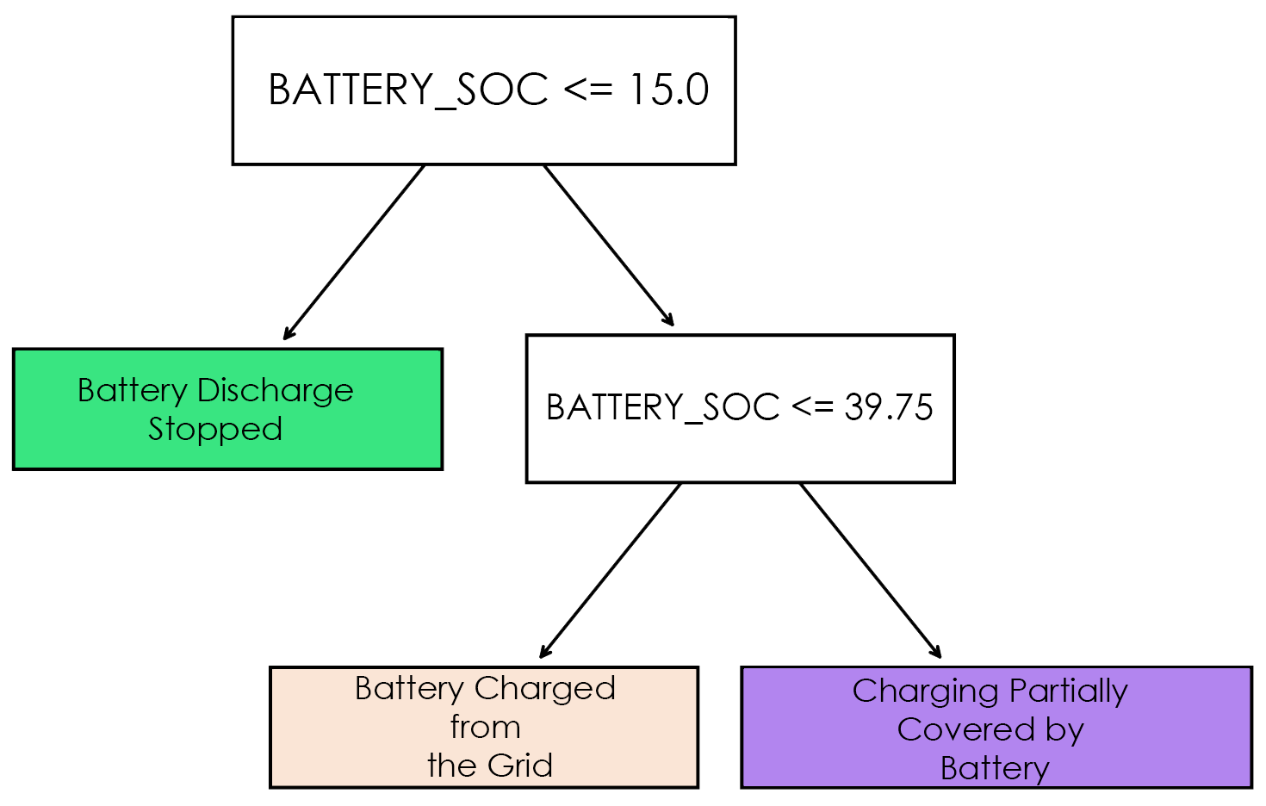
Baseline Model
Shallow decision trees
Trained on the entire dataset and cleaned subset
Extracted thresholds agree with ground truths
Interesting: Bootstrapping reveals important features
Fast-charger power
Solar power (time of day)

Slide 6
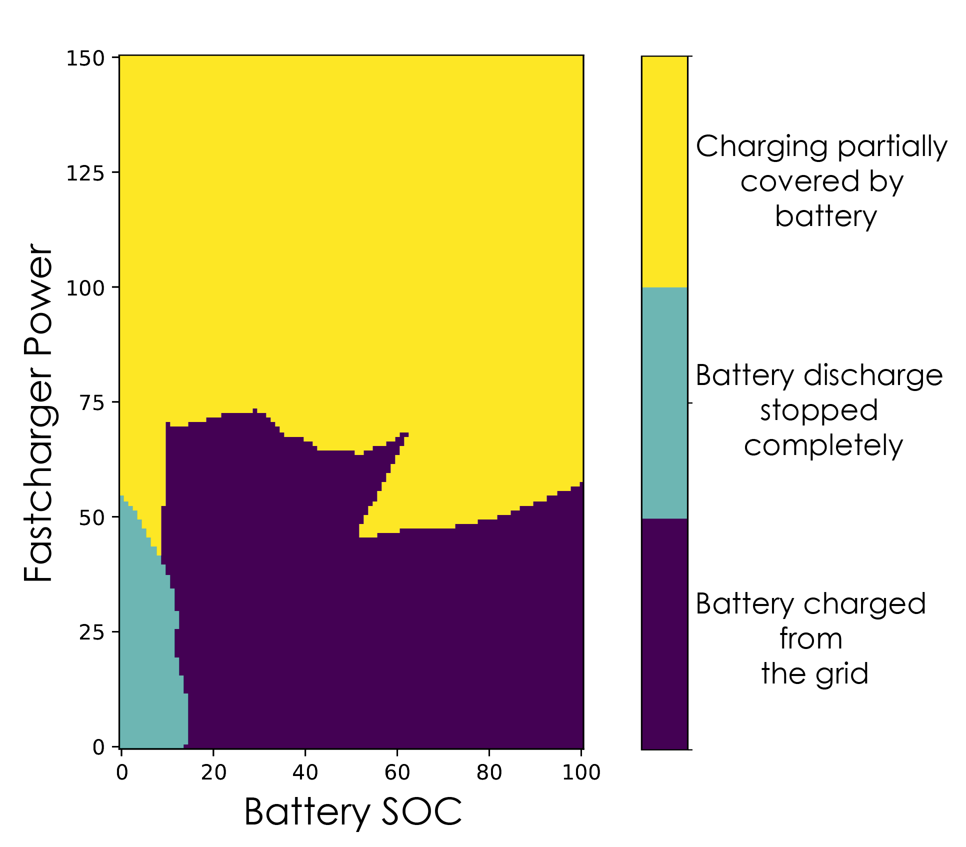
Neural Networks
Poor generalization of baseline model to the entire dataset
Fully connected MLP (5, 2, 7)
Improved thresholds with better performance ~80% accuracy
SHAP analysis of full featured model
Two parameter model generalizes with 93% accuracy

